Slide 1
Java GC

Slide 2
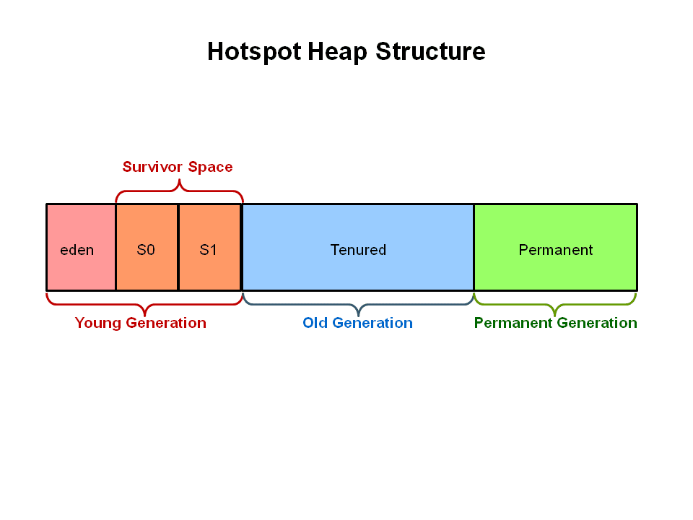
Java Heap Structure
PermGen has been replaced with Metaspace since Java 8 release.

Slide 3
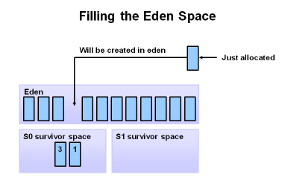
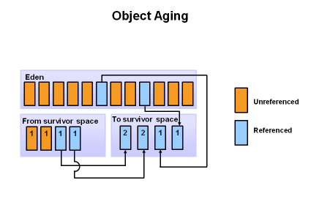
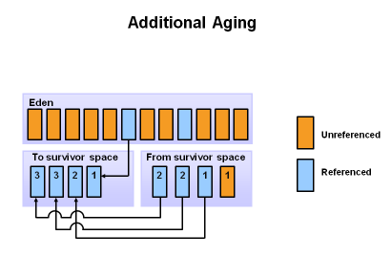
GC Overview

Slide 4
Minor GC vs Major GC
Young GC is minor GC
Minor GC is always triggered when JVM is unable to allocate space for a new Object, since the Eden is getting full.
Major GC is cleaning the Tenured/Old space.
Full GC is cleaning the entire Heap – both Young and Tenured spaces
Terms
Allocation Rate
Promotion Rate
STW Pause

Slide 5
GC Logs
-Xloggc:/tmp/gc.log
Logs all GC activity. Details can be controlled using various options
Young GC Log
2015-05-26T16:23:07.219-02001: 64.3222:[GC (Allocation Failure) 64.322: [ParNew: 613404K->68068K6(613440K), 0.1020465 secs] 10885349K->10880154K (12514816K), 0.1021309 secs][Times: user=0.78 sys=0.01, real=0.11 secs]
Major GC Log
2015-05-26T16:23:07.321-0200: 64.425: [GC (CMS Initial Mark) [1 CMS-initial-mark: 10812086K(11901376K)] 10887844K(12514816K), 0.0001997 secs] [Times: user=0.00 sys=0.00, real=0.00 secs]
2015-05-26T16:23:07.321-0200: 64.425: [CMS-concurrent-mark-start]
2015-05-26T16:23:07.357-0200: 64.460: [CMS-concurrent-mark: 0.035/0.035 secs] [Times: user=0.07 sys=0.00, real=0.03 secs]
2015-05-26T16:23:07.357-0200: 64.460: [CMS-concurrent-preclean-start]
2015-05-26T16:23:07.373-0200: 64.476: [CMS-concurrent-preclean: 0.016/0.016 secs] [Times: user=0.02 sys=0.00, real=0.02 secs]
2015-05-26T16:23:07.373-0200: 64.476: [CMS-concurrent-abortable-preclean-start]
2015-05-26T16:23:08.446-0200: 65.550: [CMS-concurrent-abortable-preclean: 0.167/1.074 secs] [Times: user=0.20 sys=0.00, real=1.07 secs]
2015-05-26T16:23:08.447-0200: 65.550: [GC (CMS Final Remark) [YG occupancy: 387920 K (613440 K)]65.550: [Rescan (parallel) , 0.0085125 secs]65.559: [weak refs processing, 0.0000243 secs]65.559: [class unloading, 0.0013120 secs]65.560: [scrub symbol table, 0.0008345 secs]65.561: [scrub string table, 0.0001759 secs][1 CMS-remark: 10812086K(11901376K)] 11200006K(12514816K), 0.0110730 secs] [Times: user=0.06 sys=0.00, real=0.01 secs]
2015-05-26T16:23:08.458-0200: 65.561: [CMS-concurrent-sweep-start]
2015-05-26T16:23:08.485-0200: 65.588: [CMS-concurrent-sweep: 0.027/0.027 secs] [Times: user=0.03 sys=0.00, real=0.03 secs]
2015-05-26T16:23:08.485-0200: 65.589: [CMS-concurrent-reset-start]
2015-05-26T16:23:08.497-0200: 65.601: [CMS-concurrent-reset: 0.012/0.012 secs] [Times: user=0.01 sys=0.00, real=0.01 secs]

Slide 6
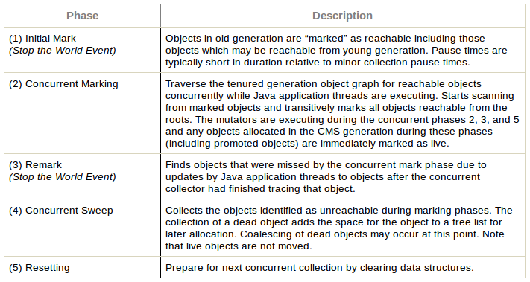
CMS GC

Slide 7
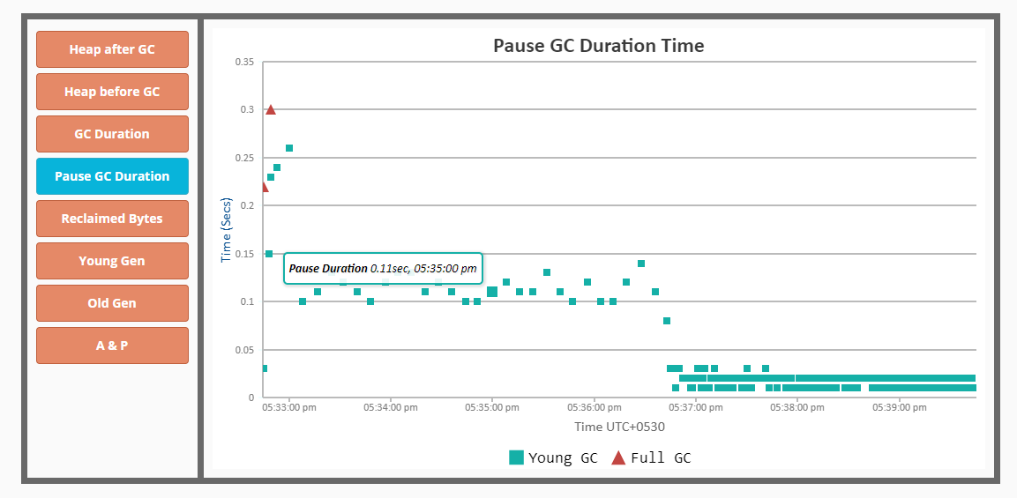
GC Latency behavior Idle vs Load

Slide 8
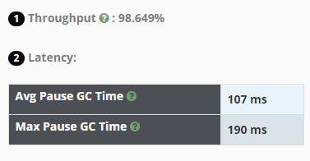
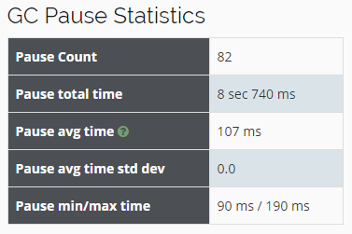
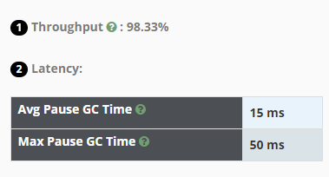
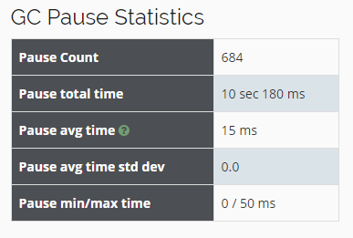
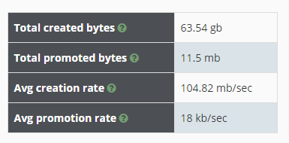

Analysis of GC pause behavior [Idle Vs Load]
Idle
With Load

Slide 9
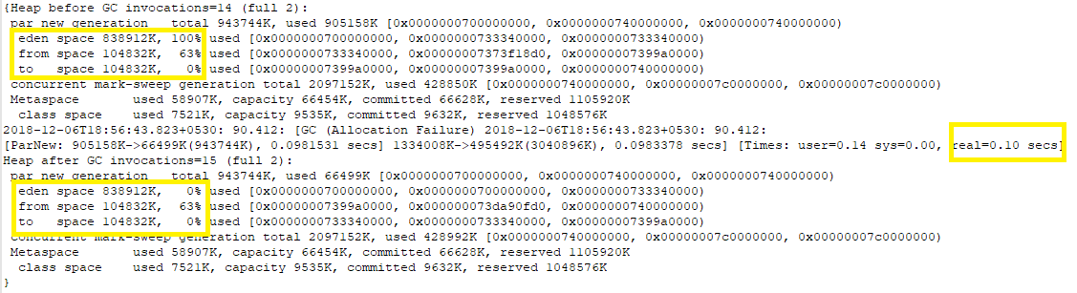
Why lower GC Pause? - Object Movement Across Survivor Regions
Idle System

Slide 10
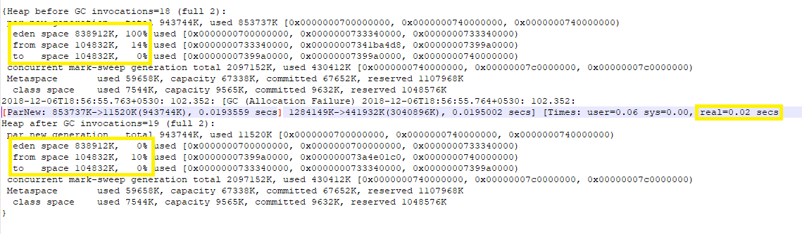
Why lower GC Pause? - Object Movement Across Survivor Regions
With Load

Slide 11
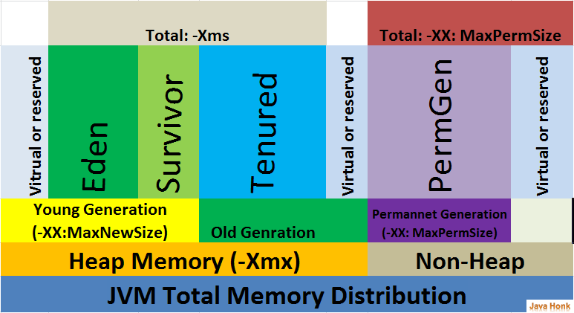
Java Heap Structure

Slide 12
Issue in Vz
Problem: Occasionally, Diameter messages gets delayed by up to 300 ms.
Why: It was observed that GC gets kicked in & delays the message processing
Probable Solution:
Tune Garbage collection to reduce GC pauses

Slide 13
Improvements done in CSD to mitigate high GC pause in Vz
Initial Heap Size is set to 1GB by default instead of keep it same as –Xmx
Survivor ratio in Young Generation is set to 6 instead of default 8
Young & Old generations are kept at same size (NewRatio=1)
Effect of the improvements:
GC Pauses came down to 10 ms
Young GC gets triggered every 10 mins approximately
Number of bytes transferred from Young to Old Gen has reduced greatly

Slide 14
Useful Tools
Jstat
Gceasy.io – Online
Jmap – Heap statistics/dump
Mat – Memory Analyser Tool
Jmc – Java Mission Control
Oracle JFR
ASRMemMonitor.py (Built In house)

